Slide 1

Robotics
Introduction to Electronic Components

Slide 2
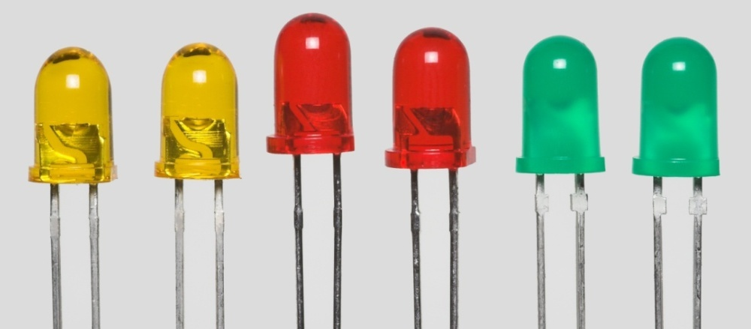
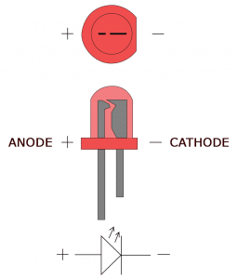
Light Emitting Diode (LED)
A light-emitting diode (LED) is a semiconductor device that emits light when an electric current passes through it.
LEDs are small, powerful lights that are used in many different applications.
A single LED consists of two terminals, an anode and a cathode. The anode is the positive terminal and the cathode is the negative terminal.
To power the LED, you connect the cathode to the ground and the anode to the voltage supply.

Slide 3
pinMode()
pinMode function configures the specified pin to behave either as an input or an output.
Syntax:
pinMode(pin, mode);
Parameters:
pin: the number of the pin whose mode you wish to set
mode: INPUT, OUTPUT
EXAMPLE: Turning on the LED
pinMode(13,OUTPUT);
Here Mode is Output because we are using the inbuilt LED as output and is connected to pin13.

Slide 4
digitalWrite()
digitalWrite function is used to write a HIGH or a LOW value to a digital pin.
If the pin has been configured as an OUTPUT with pinMode(), its voltage will be set to the corresponding value: 5V (or 3.3V on 3.3V boards) for HIGH, 0V (ground) for LOW.
Syntax:
digitalWrite(pin, value);
Parameters:
pin: the pin number
value: HIGH or LOW
Example:
digitalWrite(13, HIGH); // This function will set the output voltage of pin 13 to 5v

Slide 5
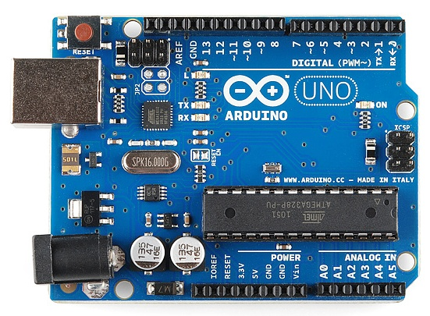
LED Blinking (inbuilt LED)
We can control that Led using Pin no 13.
Let’s create an “LED blinking” Program
Before making it blink first let’s make it glow.
(The encircled LED is internally connected to Digital Pin no 13.)

Slide 6
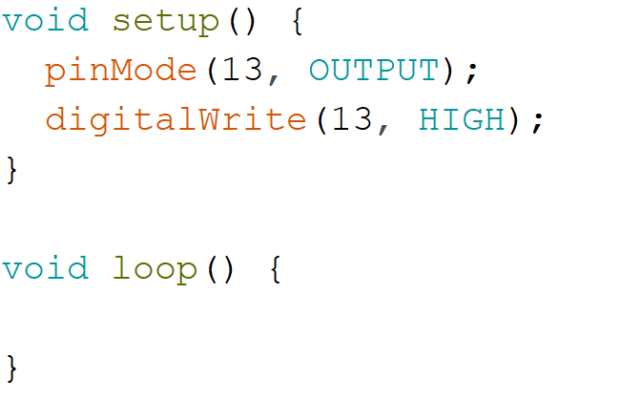
Code for Turning on Inbuilt LED
Output: LED on the Arduino board connected to Pin no 13 will be ON.

Slide 7
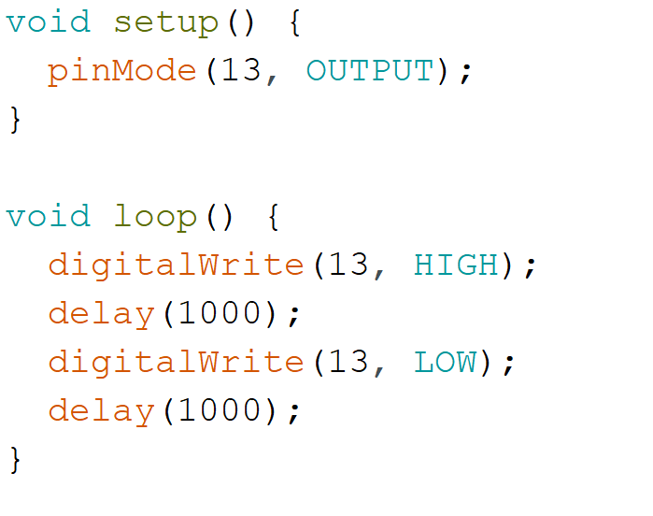
Code for blinking Inbuilt LED
Output: LED on the Arduino board connected to Pin no 13 will blink.

Slide 8
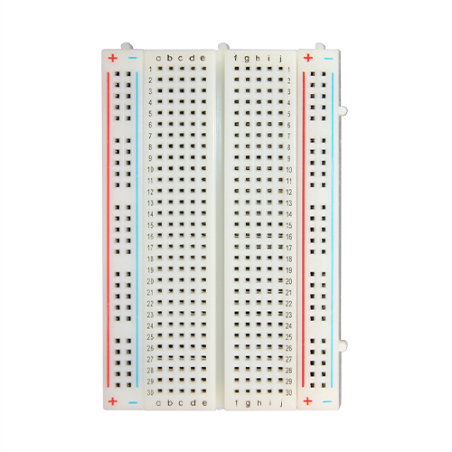
Breadboard
An electronics breadboard is actually referring to a solderless breadboard. These are great units for making temporary circuits and prototyping, and they require absolutely no soldering.
Prototyping is the process of testing out an idea by creating a preliminary model from which other forms are developed or copied, and it is one of the most common uses for breadboards. If you aren’t sure how a circuit will react under a given set of parameters, it’s best to build a prototype and test it out.

Slide 9
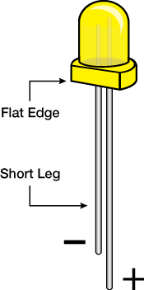
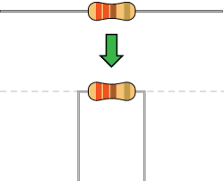
LED
The shorter of the two legs, towards the flat edge of the bulb indicates the negative terminal.
Resistor
Resistors are used to control the flow of current.
Resistors need to have their terminals bent into 90° angles in order to fit the breadboard sockets properly.
In this project we are using a resistor to control the flow of current

Slide 10
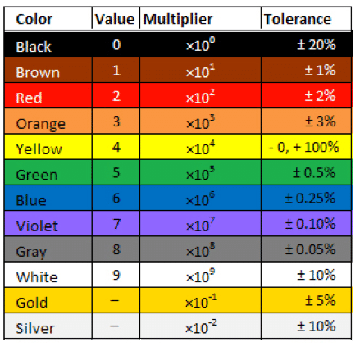
Colour code for resistor
The stripes on the resistor help you to determine the value of that particular resistor.
You need to follow the color code to determine the value.

Slide 11
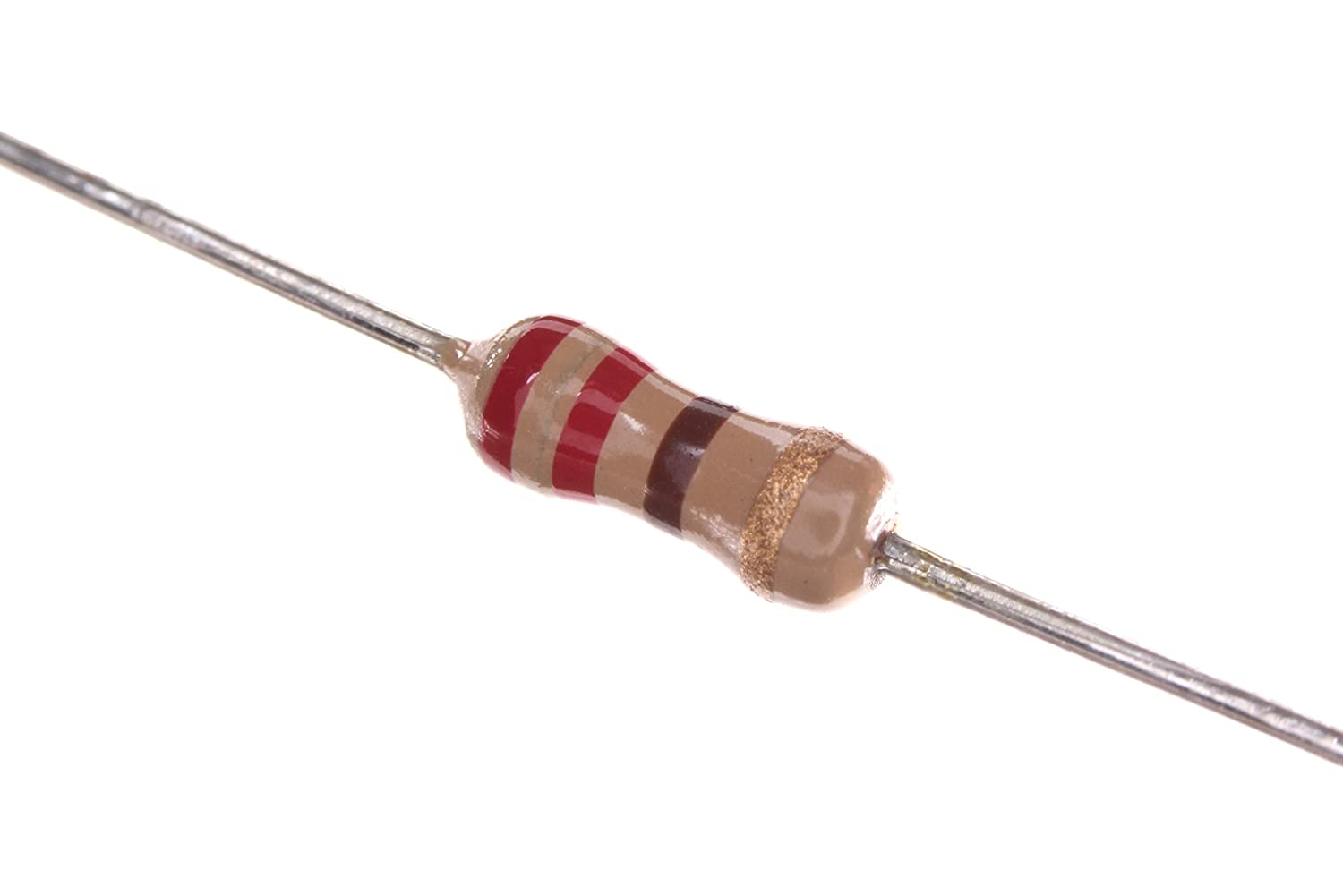
Example
For the given image, the first two striped are the first two digits of the value, so red and red mean 2, 2.
The next stripe is the number of zeros that need to come after the first two digits, so if the third strip is brown, there will be one zero and so the resistor is 220Ω.
Unlike LEDs, resistors do not have positive and negative terminals. They can be connected either way around.

Slide 12
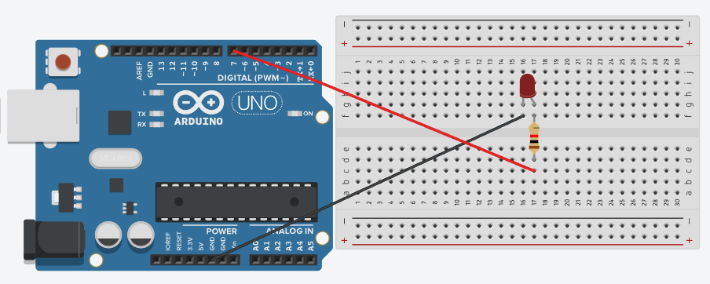
LED Anode (positive terminal) connection
Cathode Terminal
Anode Terminal

Slide 13
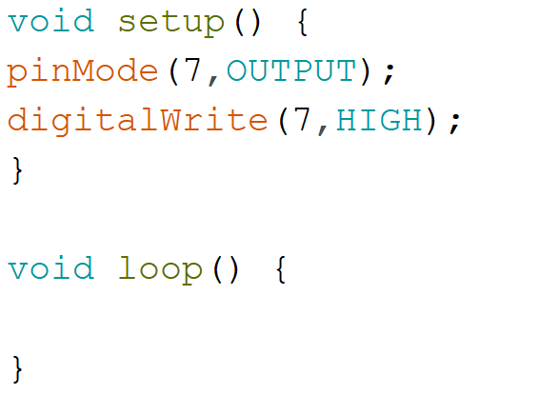
Code for Anode Connection

Slide 14
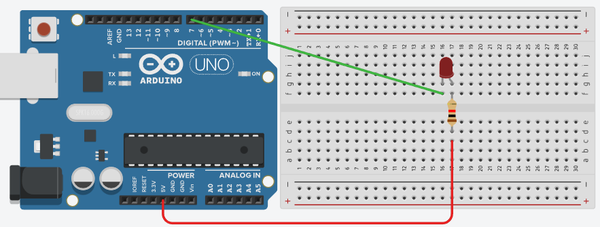
LED Cathode (negative terminal) connection
Cathode Terminal
Anode Terminal

Slide 15
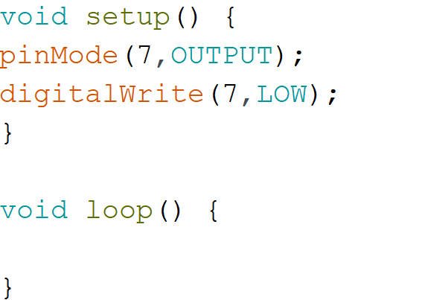
Code for Cathode Connection

